Slide 1








ARABIC DIALECT CLASSIFICATION

Slide 2





Agenda
Problem Statement
Fetch Data
Cleaning and Preprocessing
Models & Evaluation
Model Deployment

Slide 3





Problem Statement
DEVELOP A MACHINE LEARNING MODEL TO ACCURATELY CLASSIFY TWEETS WRITTEN IN DIFFERENT ARABIC DIALECTS, SPECIFICALLY TARGETING EGYPTIAN, SUDANESE, LEBANESE, MOROCCAN, AND LIBYAN DIALECTS. THIS CLASSIFICATION AIMS TO ENHANCE SOCIAL MEDIA ANALYSIS, TARGETED MARKETING, CUSTOMER SUPPORT, AND CULTURAL SENSITIVITY IN COMMUNICATIONS.

Slide 4
Fetch Data
we used the SQLite library to connect to the database.
Then, We read multiple tables and save them in CSV file.

Slide 5



Cleaning and Preprocessing
Remove Numbers
Remove URLs, Mentions, and Hashtags
Remove Non-Arabic Characters and Special Symbols
Remove Newline Characters & Punctuation
Remove Arabic Diacritics
Remove Repeated Characters
Remove Arabic Stopwords
Arabic Stemmer

Slide 6






MODELS & EVALUATION

Slide 7

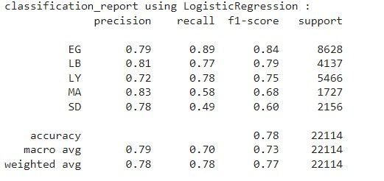

Logistic Regression with TF-IDF

Slide 8
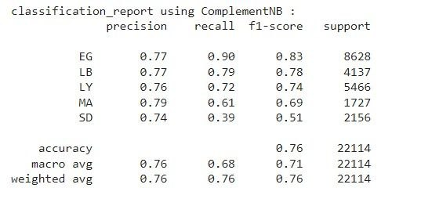
ComplementNB with TF-IDF

Slide 9
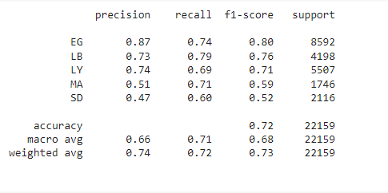
Long Short Term Memory (LSTM)

Slide 10
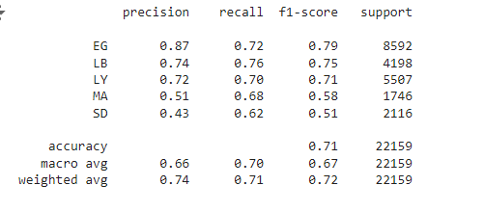
Gated Recurrent Unit(GRU)

Slide 11
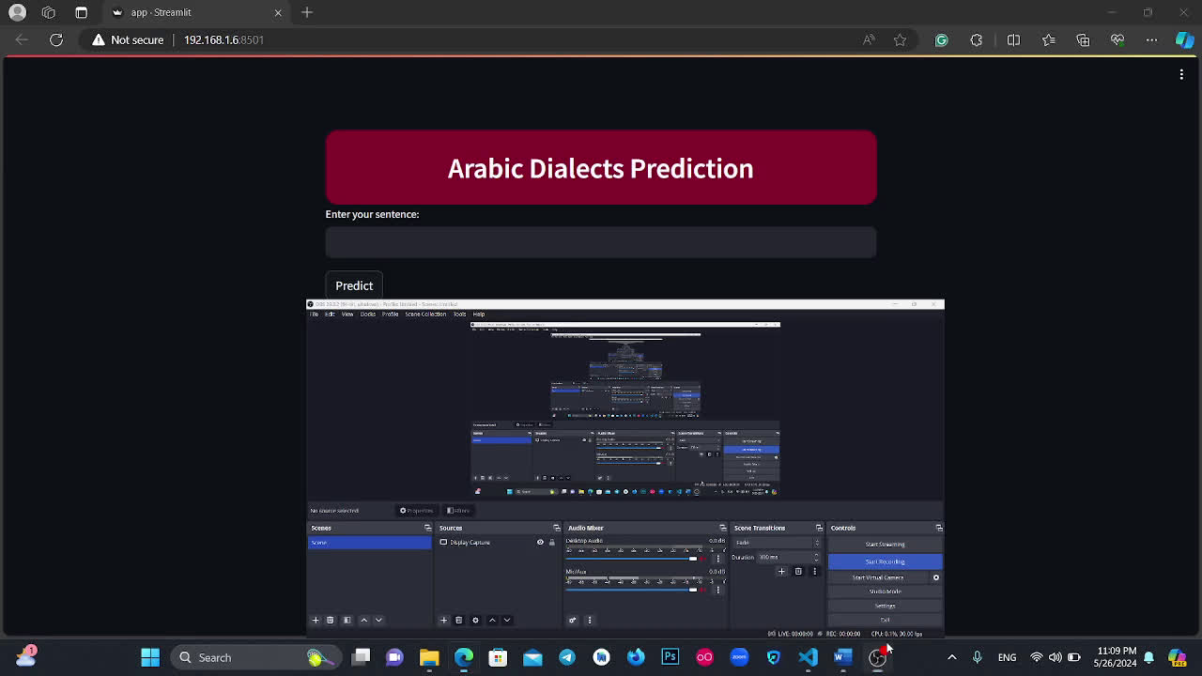
Model Deployment
Using Logistic Regression model with TF-IDF.
Doing model deployment using Streamlit.

Slide 12


